Slide 1



Day 2 – 4:00 Project Progress Report -Tympe-
Logan Schlick, Daniel Marin, Kyle Rimando, Sonny Pizzo, Shane Ghuste

Slide 2


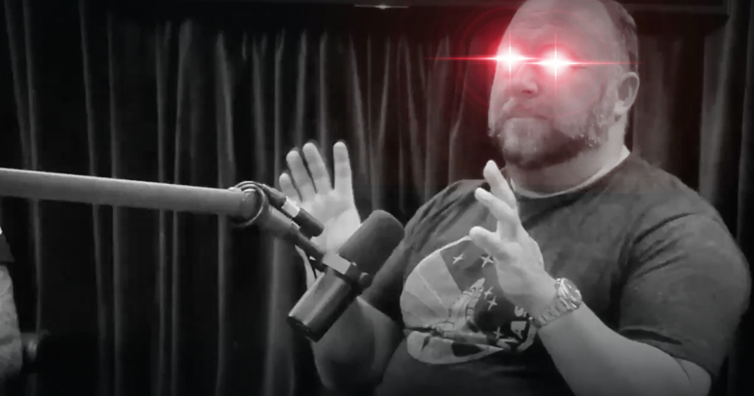

Front end progress…
Set up the count down timer tomorrow
As well as make page pretty
Front end designers:
Daniel Marin
Sonny Pizzo

Slide 3
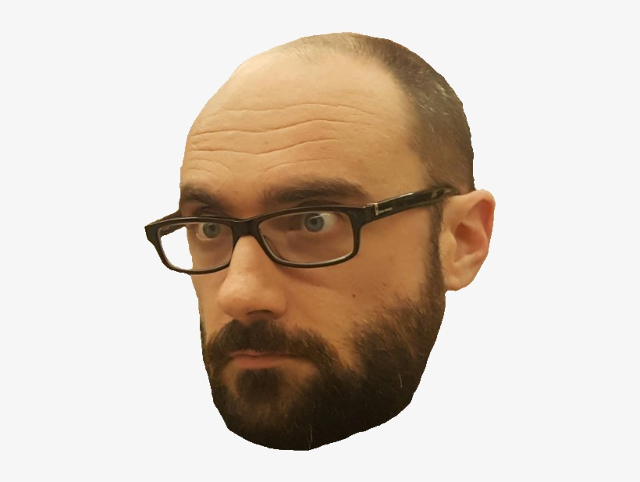
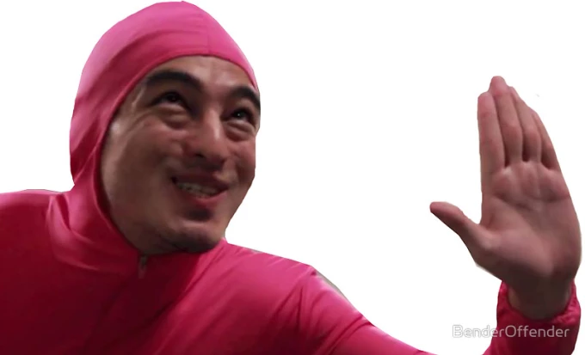

Back end progress…
Was able to link game to score board on small scale
And now we are able to link full list to score board
Next is to link a count down timer
Back end designers:
Logan Schlick
Kyle Rimando

